Slide 1


Weather Impact Analysis
- Analysis and Prediction of Weather Patterns Using Data Science and Machine Learning.
Presented By
MDZ
Weather Impact & Forecast

Slide 2
Content
Objective: Analyse and predict weather patterns using exploratory data analysis (EDA) and machine learning to understand how environmental factors like humidity, wind speed, and pressure influence temperature and overall weather conditions. Develop models capable of forecasting short-term temperature or weather trends.
Problem: Weather variations are highly dynamic and influenced by multiple correlated parameters. Manual analysis or simple statistical observation cannot accurately capture these relationships, making it difficult to predict real-time conditions or temperature fluctuations effectively.
Goal: Identify meaningful patterns within the dataset, evaluate multiple predictive models, and create a reliable system that forecasts weather conditions. This approach supports better planning for agriculture, outdoor activities, and smart-city infrastructure through data-driven weather insights.
Weather Impact & Forecast

Slide 3
Data Sources:
We used a historical weather dataset containing parameters such as temperature, humidity, pressure, wind speed, visibility, and precipitation type. > Source: Kaggle – Weather History Dataset
This dataset serves as the foundation for analysing climatic patterns, identifying correlations between variables, and predicting temperature variations.
Weather Impact & Forecast
Data Cleaning
& Preprocessing:
Duplicate and null records were removed to maintain data integrity. Time-based features such as Date, Hour, Month, and Day of Week were extracted from timestamps for temporal trend analysis.
Categorical columns like Precip Type and Wind Category were encoded into numeric values.
Feature engineering included calculating temperature differences, wind–humidity impact, and variability metrics to enhance model performance.
Data Visualization:
Comprehensive weather insights were visualized using Matplotlib and Seaborn, covering distributions, correlations, and hourly trends.
Interactive dashboards in Power BI illustrated patterns in temperature, humidity, and wind speed across different hours and months for easy, non-technical interpretation.

Slide 4

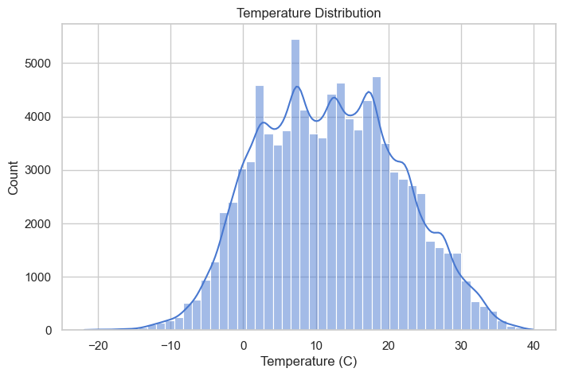
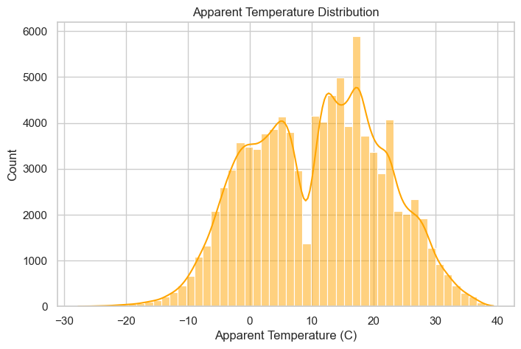
Temperature and Apparent Temperature Distribution Analysis
Out of 96,429 weather records, the average temperature was 11.93°C (±9.55°C), ranging from
–21.82°C to 39.91°C.
The distribution is nearly symmetric (skew ≈ 0.09, kurtosis ≈ –0.57), with 25% below 4.68°C, a median of 12°C,
and 75% below 18.84°C, showing mostly moderate conditions.
The apparent temperature averaged 10.85°C (±10.70°C), spanning –27.72°C to 39.34°C. Its shape is also near-normal (skew ≈ –0.06, kurtosis ≈ –0.71), closely matching the actual temperature pattern with small deviations due to humidity and wind chill.
Weather Impact & Forecast

Slide 5
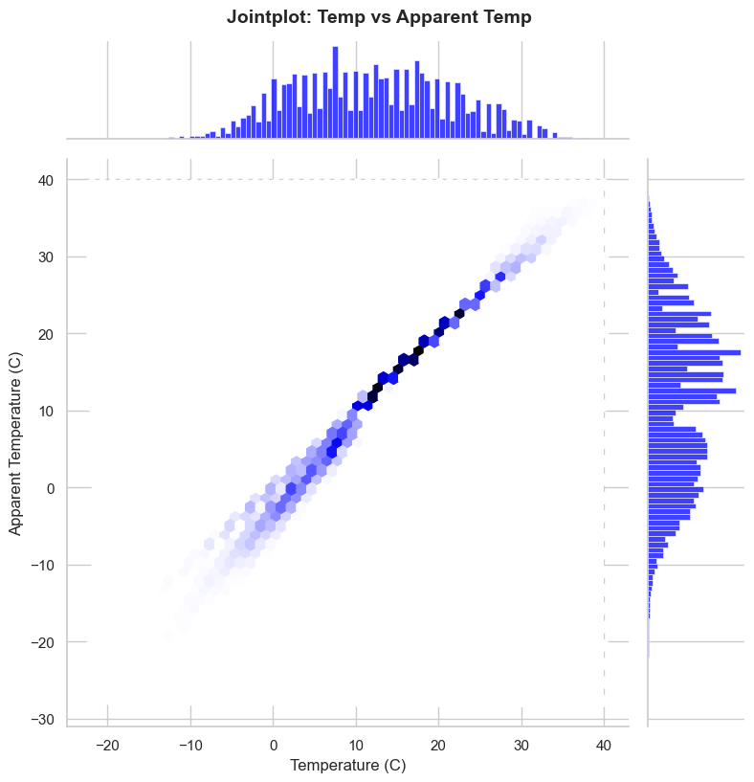
Temperature vs Apparent Temperature
Out of 96,429 weather records, average
temperature was approximately 11.93°C,
while the average apparent temperature
(considering wind chill and humidity effects)
was slightly lower at 10.85°C.
Temperature (C): ranged from –21.82°C to 39.91°C
Apparent Temperature (C): ranged from –27.72°C to 39.34°C
The distribution of both actual and apparent temperatures is fairly symmetric
Temperature skewness ≈ 0.09, kurtosis ≈ –0.57
Apparent Temperature skewness ≈ –0.06, kurtosis ≈ –0.71
25% of temperatures are below ~4.68°C, median is 12°C, and 75% are below ~18.84°C
25% of apparent temperatures are below ~2.31°C, median is 12°C, and 75% are below ~18.84°C
Weather Impact & Forecast

Slide 6
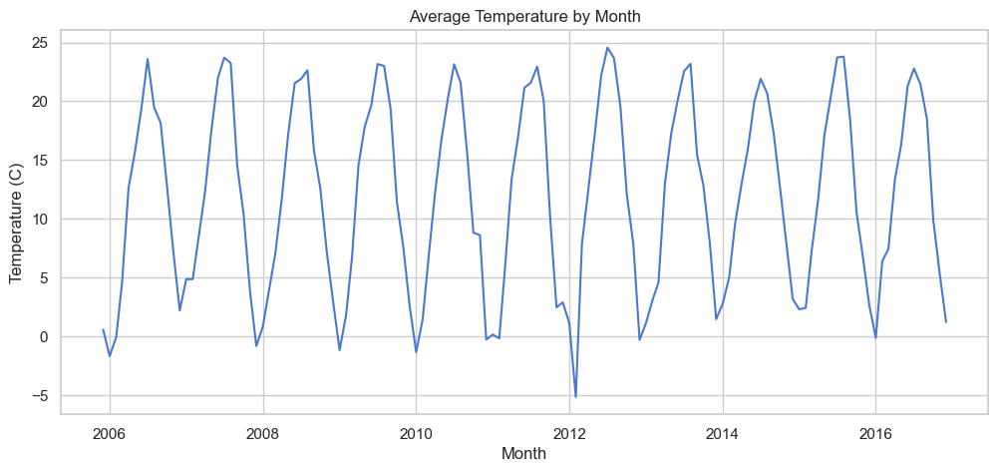
Temperature Summary by Month
Temperature rises gradually from winter (Dec–Feb, ~–1°C to 1°C) to summer (May–Aug, ~21°C), then declines toward winter again (~1–5°C in Nov–Dec).
Weather Impact & Forecast
Seasonal variation is evident: the lowest monthly temperature recorded ~–14°C, while the highest reached ~32°C.
Median monthly temperatures closely follow the mean, indicating consistent seasonal patterns.
The interquartile range (25th–75th percentile) reflects moderate variability, with larger spreads in transitional months (spring/fall) and smaller spreads in summer/winter.

Slide 7
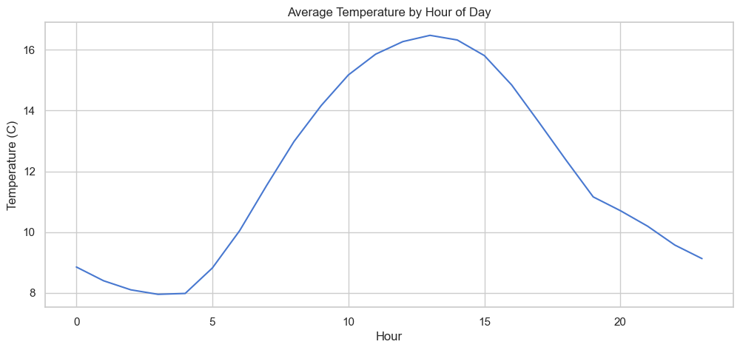
Temperature Summary by Hour (°C)
Temperatures vary significantly across the day, with early morning (0–4 AM) being the coldest (~7–9°C on average) and late afternoon (12–15 PM) the warmest (~16°C on average).
Weather Impact & Forecast
Minimum temperatures can drop below –21°C during early hours, while the maximum can reach ~39.9°C in the afternoon.
The 25th–75th percentile range shows moderate daily variation: early morning (~2–15°C), midday (~7–25°C), and evening (~4–22°C).
Median temperatures follow a smooth daily cycle, rising after sunrise and peaking around 13–14 PM, then gradually cooling toward midnight.

Slide 8
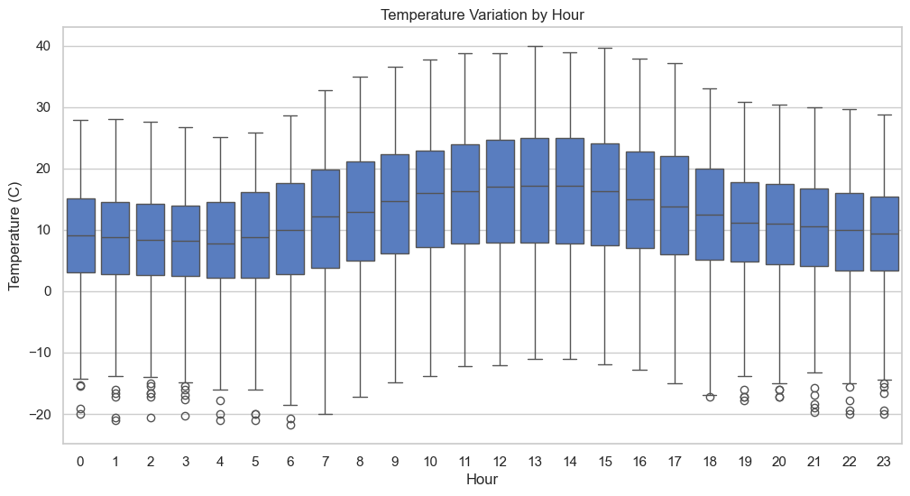
Temperature Summary by Hour (°C)
Temperatures range from –21.82°C to 39.91°C.
0–5 AM: Coldest hours, mean ~7–8.8°C.
6–11 AM: Gradual warming.
12–15 PM: Hottest period, mean ~16°C, peaks near 39.9°C.
16–23 PM: Cooling trend toward night.
Median temperatures closely follow the mean; distributions slightly skewed in early hours and flatter in afternoon.
Weather Impact & Forecast

Slide 9
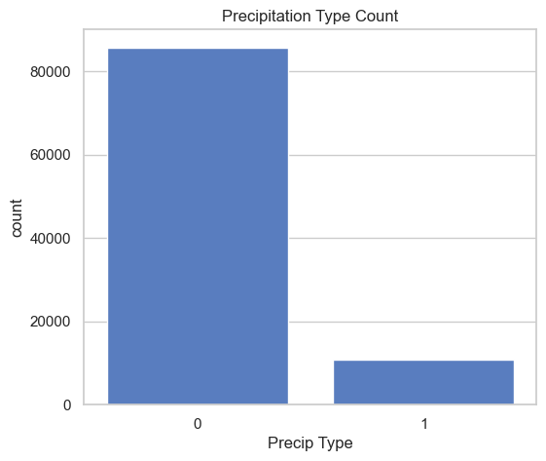
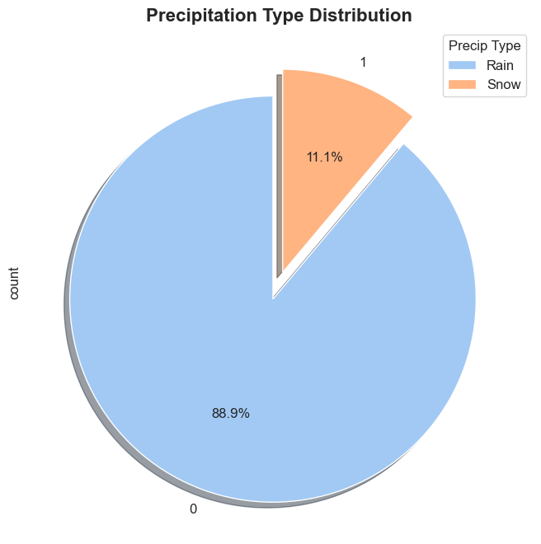
Precipitation Type Summary
Out of 96,429 weather records, the majority of observations (approximately 85,717 records, or 88.9%) correspond to Rain, while Snow occurs in 10,712 records (11.1%).
This indicates that rainfall is the predominant form of precipitation in the dataset, with snowfall being relatively rare.
Sample records show that Rain (coded as 0) dominates the initial observations, consistent with the overall distribution.
Weather Impact & Forecast

Slide 10
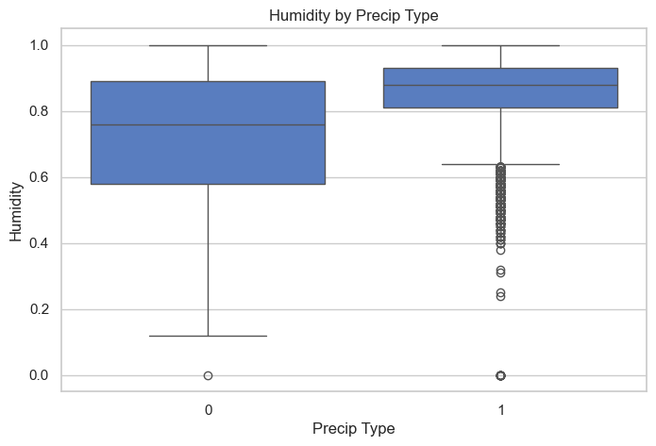
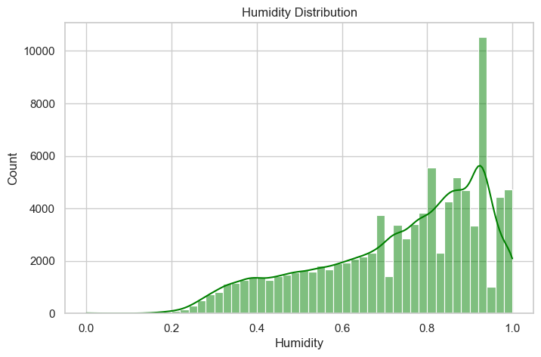
Humidity Overview
Average humidity: ~73.5%, standard deviation: 19.5% → moderate variability in moisture levels.
Range: 0% (completely dry) to 100% (fully saturated).
Slightly left-skewed (skew ≈ –0.72) and flat (kurtosis ≈ –0.46), indicating most values are clustered toward higher
humidity.
Quartiles: 25% < 60%, median ≈ 78%, 75% < 89%. Most readings are moderately to highly humid.
Rain (0): 85,717 records; mean ≈ 71.9%, median ≈ 76%, std ≈ 19.8%; range 0–100%.
Snow (1): 10,712 records; mean ≈ 86.3%, median ≈ 88%, std ≈ 11.1%; range 0–100%; mostly consistently humid.
Representative humidity readings: 0.89, 0.86, 0.83, 0.95, 0.72, 0.54, 0.51, 0.47, 0.60, 0.70 (all Rain).
Snow generally occurs with higher, more stable humidity.
Rain conditions show slightly more variability in moisture levels.
Weather Impact & Forecast

Slide 11
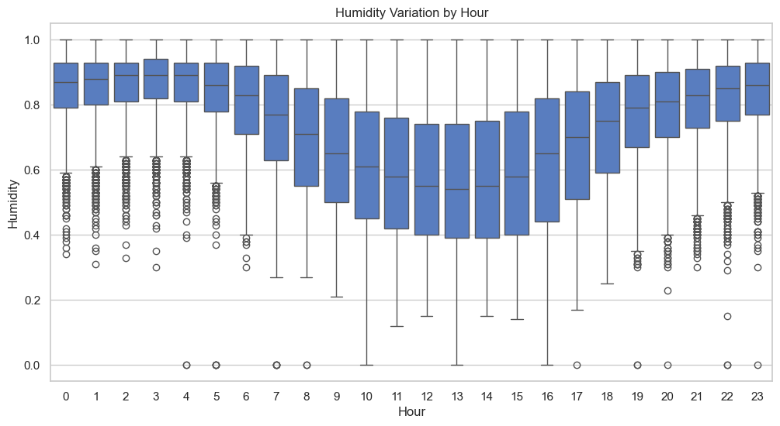
Humidity Variation by Hour
Early morning (03:00–04:00) is most humid (~0.87), midday lowest (~0.57–0.59), evening rises again
(~0.78–0.84).
Morning skew negative (high values dominate), midday slightly positive (more balanced).
Kurtosis shows peaked distributions early/late, flatter during the day.
Clear daily pattern useful for weather analysis and urban planning.
Minimum hourly humidity: 0.00, Maximum: 1.0.
Weather Impact & Forecast

Slide 12
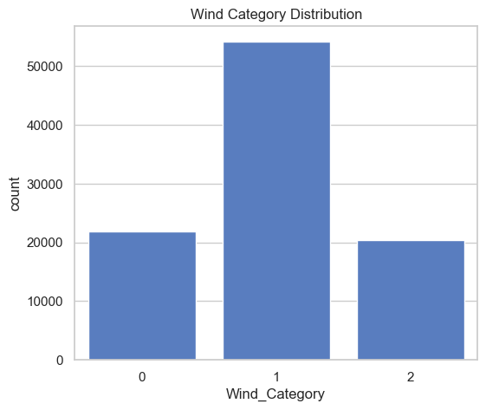
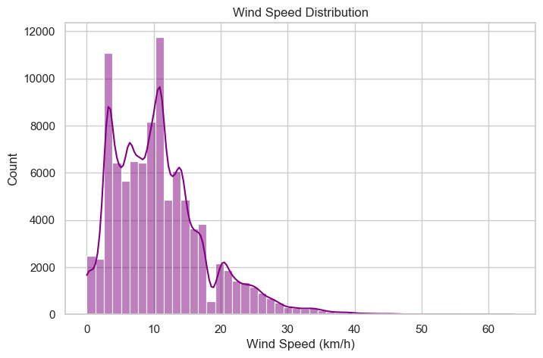
Wind Speed (km/h) Summary
Wind Speed by Wind Category
Category 0 (Light wind) is the most frequent among low-speed observations.
Category 1 (Moderate wind) dominates in overall data, mostly between 5–15 km/h.
Category 2 (Strong wind) shows high variability with some extreme gusts, causing positive skew.
Wind Speed (km/h) Summary
Total observations: 96,429
Average wind speed: ~10.81 km/h
Variation: Standard deviation ≈ 6.91 km/h
Range: Minimum 0 km/h, Maximum
63.85 km/h
Quartiles: 25% = 5.83, Median = 9.97, 75% = 14.14 km/h
Distribution: Positively skewed (skewness ≈ 1.11), moderate peak (kurtosis ≈ 1.77)
Weather Impact & Forecast

Slide 13
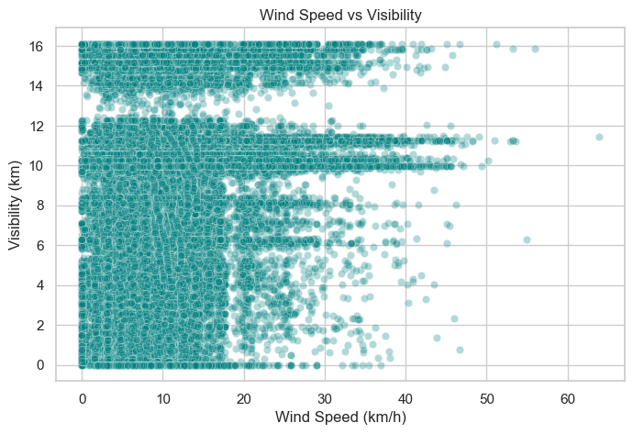
Visibility (km) Summary
Weather Impact & Forecast
Visibility (km) Summary
Total observations: 96,429
Average visibility: ~10.35 km
Variation: Standard deviation ≈ 4.19 km
Range: Minimum 0 km, Maximum 16.1 km
Quartiles: 25% = 8.34, Median = 10.05, 75% = 14.81 km
Distribution: Slightly left-skewed (skewness ≈ -0.50), flat distribution (kurtosis ≈ -0.26)

Slide 14
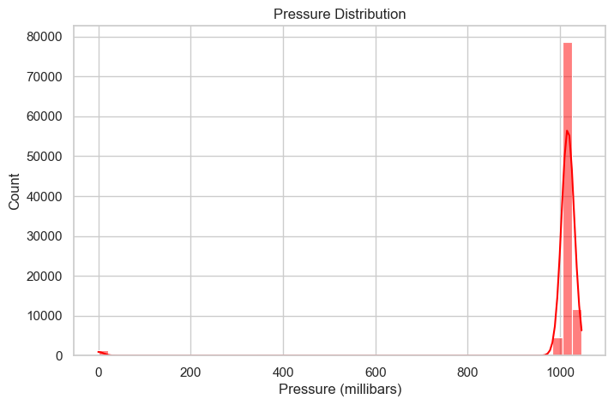
Pressure (millibars) Summary
Observations: 96,429
Average Pressure: 1003.23 mb
Standard Deviation: 116.98 mb
Minimum Pressure: 0.0 mb
25th Percentile: 1011.90 mb
Median (50th Percentile): 1016.45 mb
75th Percentile: 1021.09 mb
Maximum Pressure: 1046.38 mb
Skewness: -8.42 → Highly left-skewed
Kurtosis: 69.25 → Very heavy-tailed / peaked distribution
Weather Impact & Forecast

Slide 15
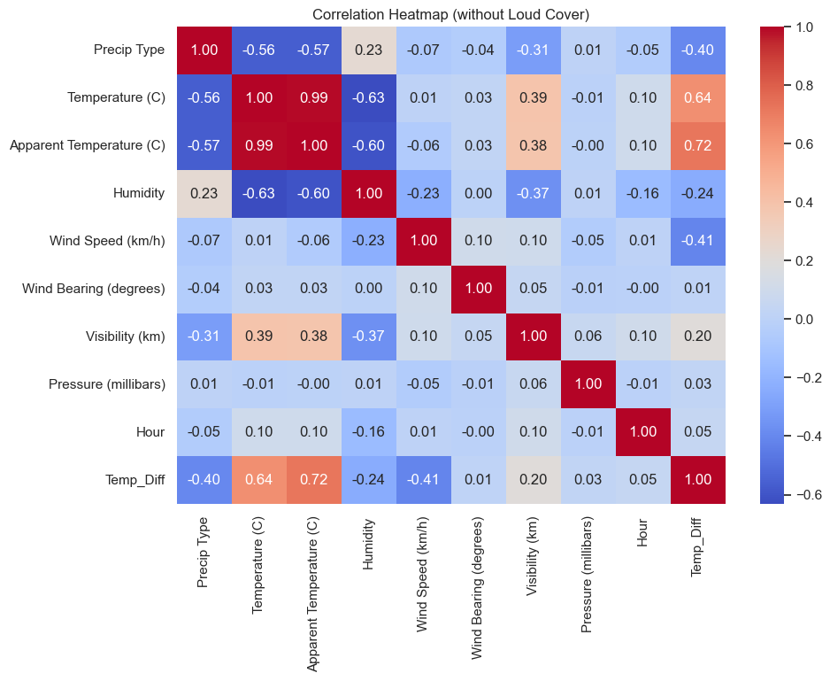
Correlation Heatmap Summary
Temp & Apparent Temp:
Very strong positive (0.99)
Temp & Temp_Diff:
Strong positive (0.64),
Apparent Temp & Temp_
Diff: Strong positive (0.72)
Temp & Humidity: Moderate negative (-0.63), Apparent Temp & Humidity: Moderate negative (-0.60)
Humidity & Precip Type: Weak positive (0.23)
Visibility & Temp: Moderate positive (0.39), Visibility & Humidity: Moderate negative (-0.37)
Wind Speed & Temp_Diff: Moderate negative (-0.41)
Precip Type & Temp: Moderate negative (-0.56), Precip Type & Temp_Diff: Moderate negative (-0.40)
Other variables (Wind Bearing, Pressure, Hour): Very weak correlations (≈0)
Weather Impact & Forecast

Slide 16
Over all Insights & Summary
Weather Dataset Overview
Records: 96,429
Temperature: Avg ~11.93°C, range -21.82°C to 39.91°C
Humidity: Avg ~73% (median 78%)
Wind Speed: Avg ~10.81 km/h, peaks up to 63.85 km/h
Precipitation: ~11% of records
Pressure: Avg ~1003.23 millibars, highly variable (std ~116.98)
Visibility: Avg ~10.35 km
Key Insights
Temperature:
Apparent Temp strongly correlates with Temperature (0.99).
AvgTemp_per_Day correlates highly (0.92) → daily averages are good predictors.
Hourly variability is significant (Temp_std_per_Hour ~8.99°C).
2. Humidity
Negative correlation with Temperature (-0.63).
Hourly variability substantial (Humidity_cv_per_Hour ~0.23).
Weather Impact & Forecast

Slide 17
Over all Insights & Summary
3. Wind
Avg ~10.81 km/h, moderate variability (WindSpeed_std_per_Hour ~6.65 km/h).
Strong correlation with Wind_Humidity_Impact (0.88) → affects weather perception.
4. Visibility & Pressure
Visibility correlates moderately with Temperature (0.39).
Pressure highly variable (std ~116.98), minimal correlation with other variables.
5. Temporal Trends
Temperature & humidity fluctuate by hour, day, week, month, quarter.
DayOfWeek has minimal effect on weather patterns.
6. Extreme Weather Events
Precipitation correlates negatively with Temperature (-0.56) and Visibility (-0.31).
Temp_Diff moderately correlates with precipitation (0.40) → larger differences often precede precipitation.
7. Correlation Highlights with Temperature
Strong positive: Apparent Temp (0.99), AvgTemp_per_Day (0.92), Visibility (0.39)
Negative: Humidity (-0.63), Temp_Diff (-0.72)
Moderate correlations: Temp_std_per_Hour, Humidity_std_per_Hour (~0.30)
Weather Impact & Forecast

Slide 18
Over all Insights & Summary
Weather Impact & Forecast
Key Takeaways
Temperature prediction: Best explained by daily & apparent temperature, humidity and visibility are secondary factors.
Humidity patterns: Inversely follow temperature trends; hourly variability significant.
Wind influence: Variability and humidity interactions affect weather perception.
Precipitation effects: Reduces visibility and affects temperature differences, indicating weather event severity.
Temporal effects: Month, week, and hour influence temperature trends; useful for seasonal modeling.

Slide 19

Over all Insights & Summary
Key Takeaways
Temperature prediction: Best explained by daily & apparent temperature; humidity and visibility are secondary factors.
Humidity patterns: Inversely follow temperature trends; hourly variability significant.
Wind influence: Variability and humidity interactions affect weather perception.
Precipitation effects: Reduces visibility and affects temperature differences, indicating weather event severity.
Temporal effects: Month, week, and hour influence temperature trends; useful for seasonal modeling.
Weather Impact & Forecast

Slide 20
RECOMMENDATIONS
1. Monitor Critical Weather Parameters
Track Temperature, Apparent Temperature, and Humidity closely; they are the most
dynamic and significantly influence weather perception and comfort.
Monitor Temp_Diff (temperature change per hour) and Temp_Apparent_Ratio to detect
sudden weather shifts.
Regularly calibrate sensors to maintain reliable readings for Pressure, Wind Speed, and Visibility.
Use Humidity_cv_per_Hour and Temp_cv_per_Hour to identify periods of high variability that may indicate unstable weather conditions.
2. Seasonal and Temporal Planning
Summer months (June–July): Prepare for high temperatures; leverage AvgTemp_per_Day trends for heatwave planning.
Monsoon season: Plan around high humidity and precipitation (~11% of records), using AvgHumidity_per_Day for preparedness.
Use WeekOfYear, Month, and Quarter trends to forecast seasonal patterns.
Create alerts for sudden drops or spikes in temperature to mitigate seasonal hazards.
Weather Impact & Forecast

Slide 21
RECOMMENDATIONS
3. Safety & Public Awareness
Issue advisories during extreme temperatures, high winds, or storm events.
Monitor Visibility (km) to provide warnings for road, air, and marine transport.
Educate the public on heat index, humidity impacts, and wind-humidity interactions.
Implement storm-warning systems, especially in high-precipitation or high Wind_Humidity_Impact areas.
4. Infrastructure & Environmental Preparedness
Design urban infrastructure to adapt to temperature extremes and high humidity: cooling shelters,
shaded areas, and efficient storm drainage.
Track Pressure (millibars) for early storm detection.
Use wind speed and visibility data to enhance safety in airports, roads, and shipping routes.
Promote green building practices to buffer temperature and humidity effects.
Weather Impact & Forecast

Slide 22
RECOMMENDATIONS
5. Data-Driven Forecasting
Use hourly averages (AvgTemp_per_Hour, AvgHumidity_per_Hour, AvgPressure_per_Hour)
for precise short-term forecasts.
Combine daily and seasonal averages for longer-term predictions.
Utilize correlations (e.g., Temperature vs. Apparent Temp 0.99, vs. Humidity -0.63) to refine models.
Employ variability metrics (Temp_std_per_Hour, Humidity_std_per_Hour) to anticipate extreme weather events.
6. Environmental & Climate Impact
Identify areas with high Temp_std_per_Hour and Wind_Humidity_Impact to evaluate environmental risk zones.
Monitor extreme weather events to strengthen climate resilience policies.
Use variability and correlation metrics to improve early warning systems for environmental hazards.
Track pollution and weather patterns together for urban health and environmental planning.
Weather Impact & Forecast

Slide 23
RECOMMENDATIONS
7. Community Engagement & Awareness
Provide real-time dashboards for public weather alerts and forecasts.
Educate citizens on interpreting weather metrics and warnings.
Collaborate with local agencies for rapid response to extreme weather.
Encourage community reporting of unusual weather phenomena to improve dataset accuracy.
8. Key Takeaways for Action
Always track Temperature and Apparent Temperature together; they are the most predictive variables.
Humidity patterns strongly affect comfort, visibility, and environmental conditions.
Hourly and daily averages are crucial for accurate forecasting.
Monitor wind and visibility in real-time for transport safety.
Precipitation, Temp_Diff, and Wind_Humidity_Impact metrics help predict extreme weather severity.
Implement data-driven monitoring systems to improve public safety, seasonal planning, and resilience.
Weather Impact & Forecast

Slide 24
THANK YOU - End of Slide
Weather Impact Analysis
Weather Impact & Forecast
Presented By
MDZ

